Slide 1
Greek Gods and Goddesses

Slide 2
Mount Olympus: Home of the Gods

Slide 3
The Olympian Gods: Family Tree
Cronos
Rhea
Hades
Poseidon
Hestia
Demeter
Zeus
Hera
Hephaestus
Ares
Aphrodite
Hermes
Dionysus
Artemis
Apollo
Athena

Slide 4
Zeus

Slide 5
Poseidon

Slide 6
Hestia

Slide 7
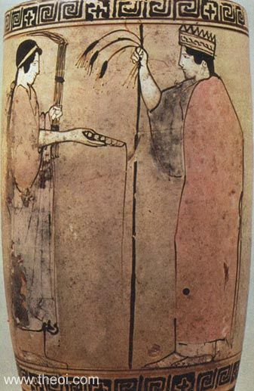
Demeter Persephone Hades

Slide 8
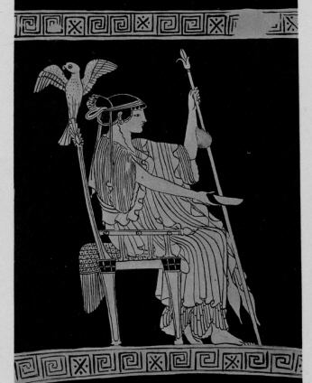
Hera

Slide 9
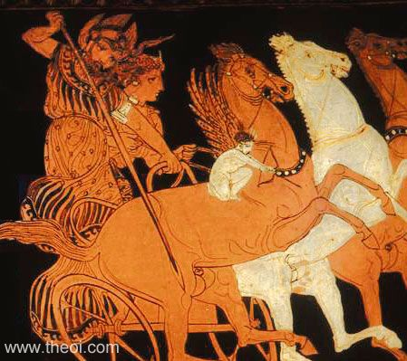
Aphrodite Ares Eros

Slide 10
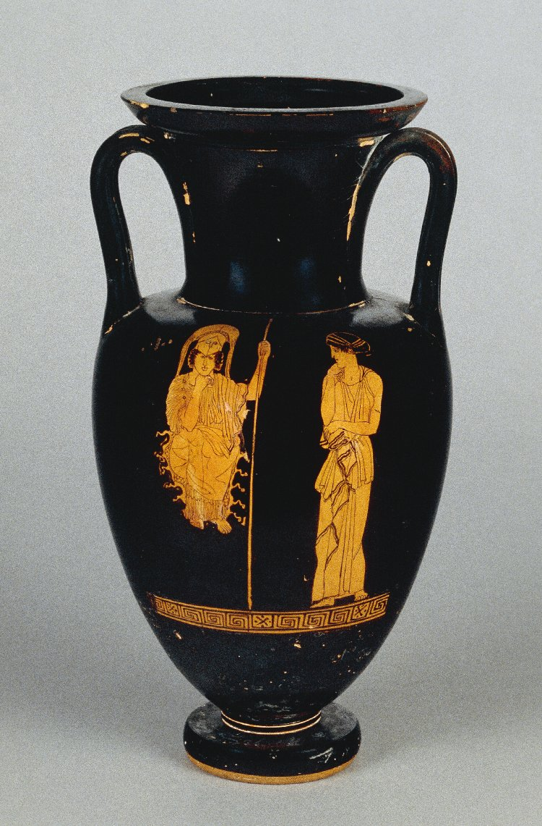
Athena Hephaestus

Slide 11
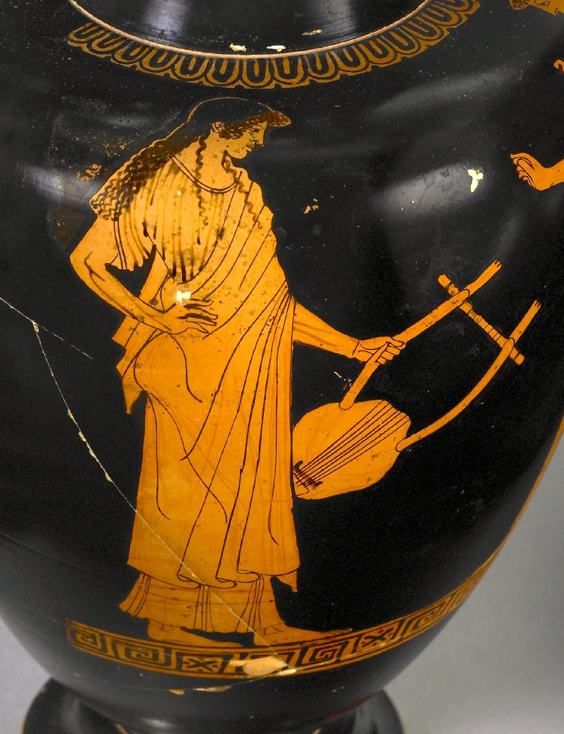
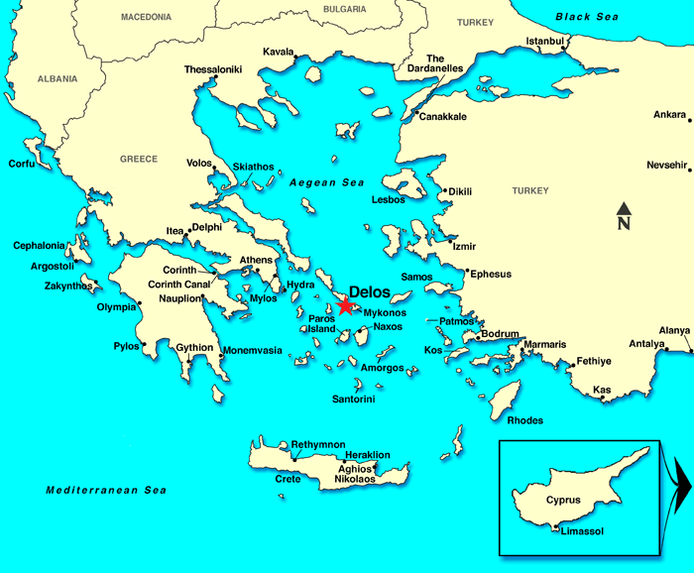
Apollo Artemis

Slide 12
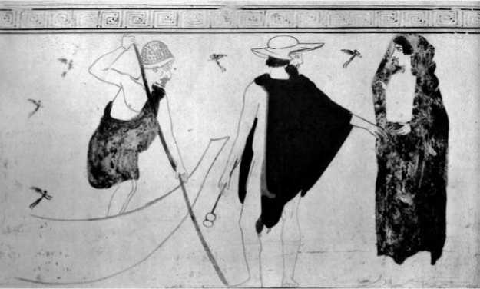
Hermes

Slide 13
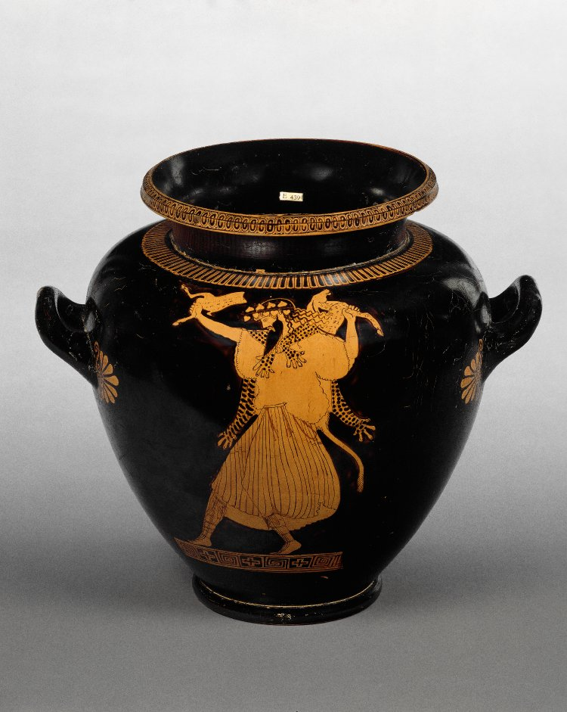
Dionysus

Slide 14
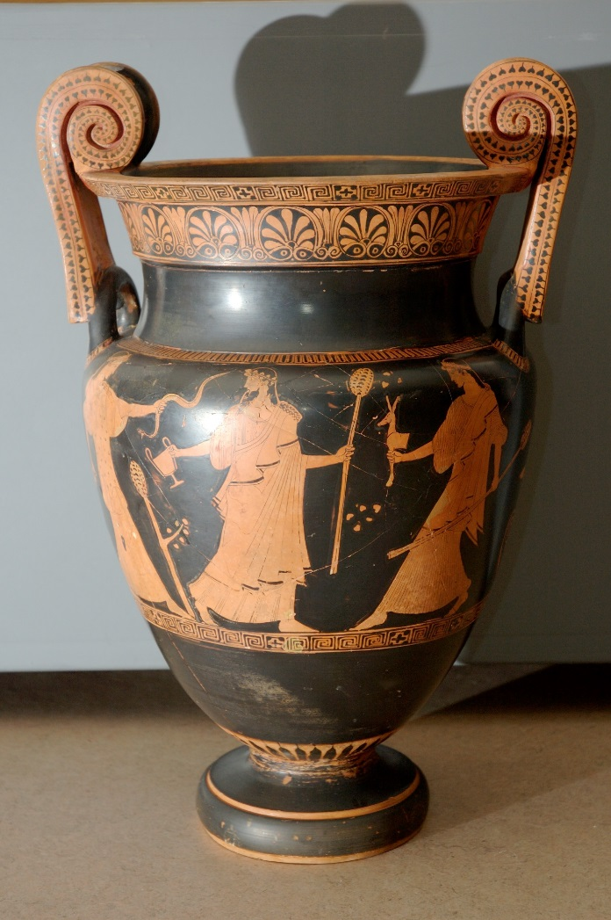
Can you guess which gods are shown here?

